Slide 1
ZMax Headband Dataset
Bad channel and Noise Issues

Slide 2
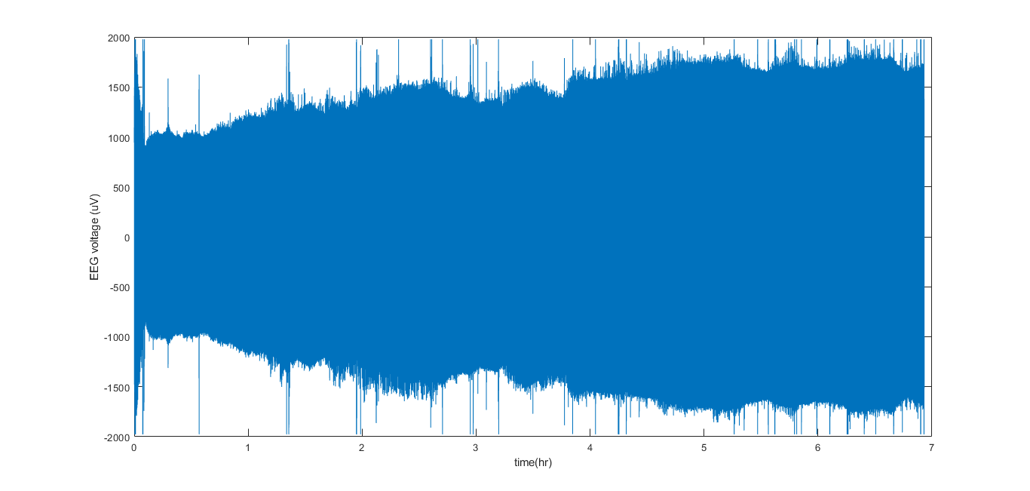
FP2 (EEG R) Channel Behaviours
Subject : S12, night2, FP2

Slide 3
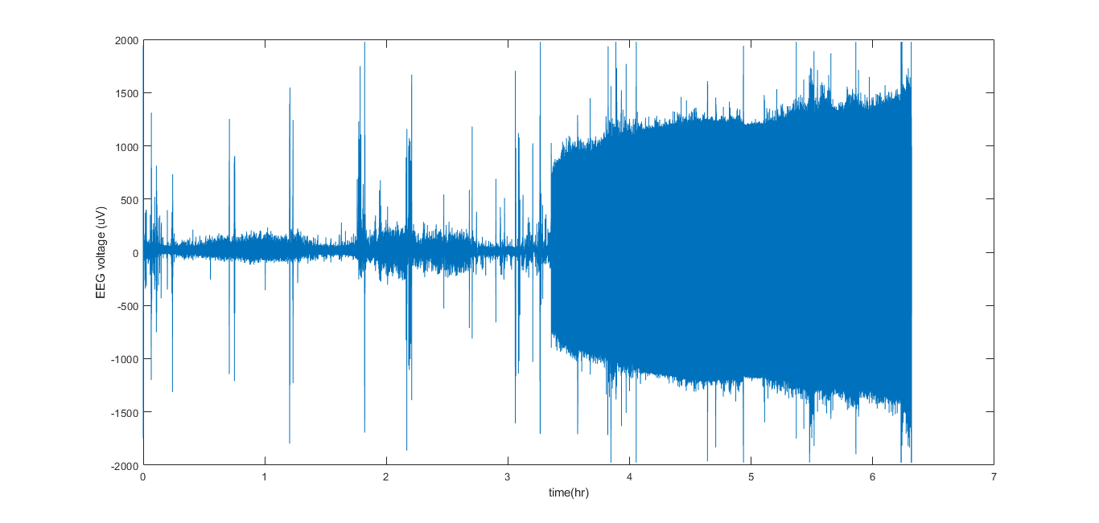
FP2 (EEG R) Channel Behaviours
Subject : S12, night3, FP2

Slide 4
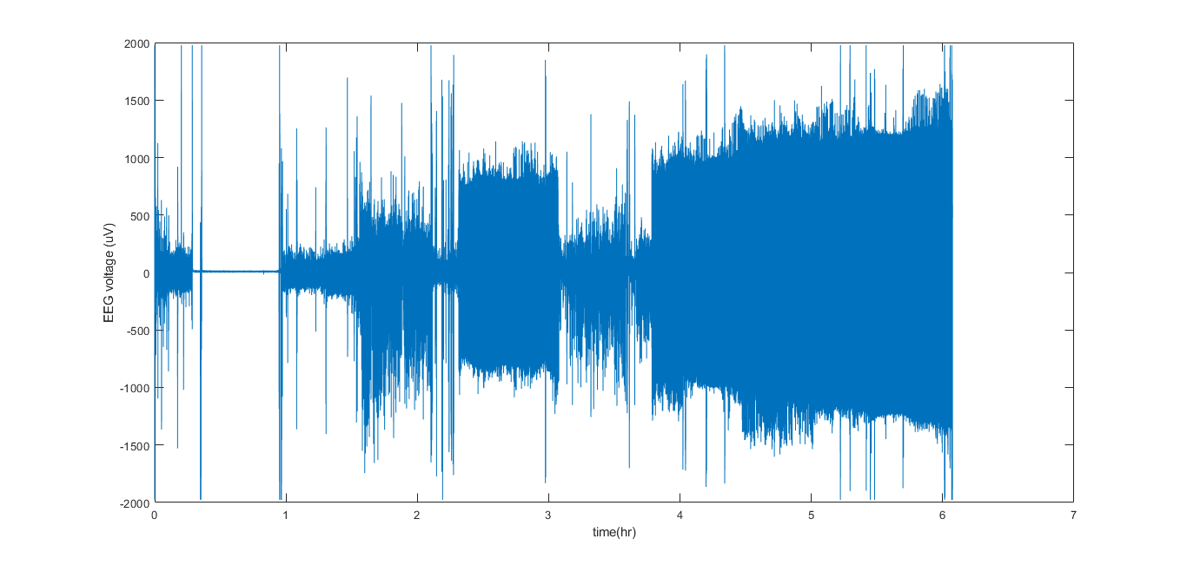
FP2 (EEG R) Channel Behaviours
Subject : S15, night2, FP2

Slide 5
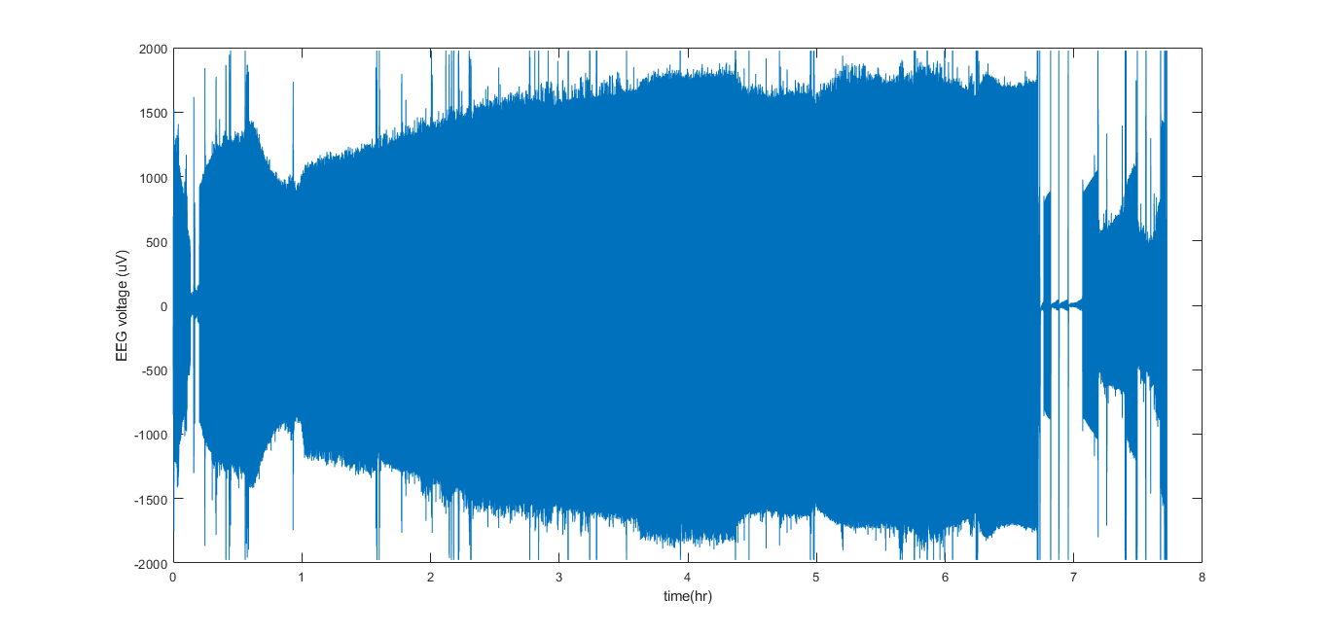
FP2 (EEG R) Channel Behaviours
Subject : S15, night3, FP2

Slide 6
Power Spectral

Slide 7
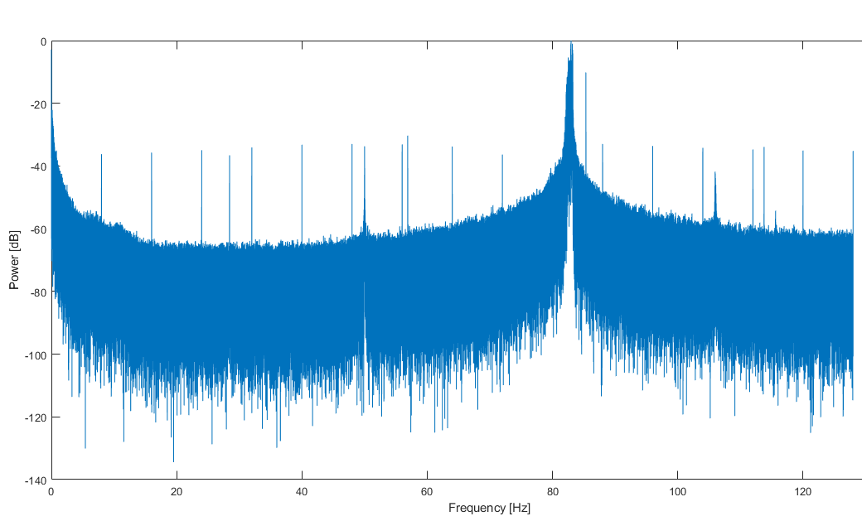
FP2 (EEG R) Channel Power Spectral
Subject : S12, night2, FP2

Slide 8
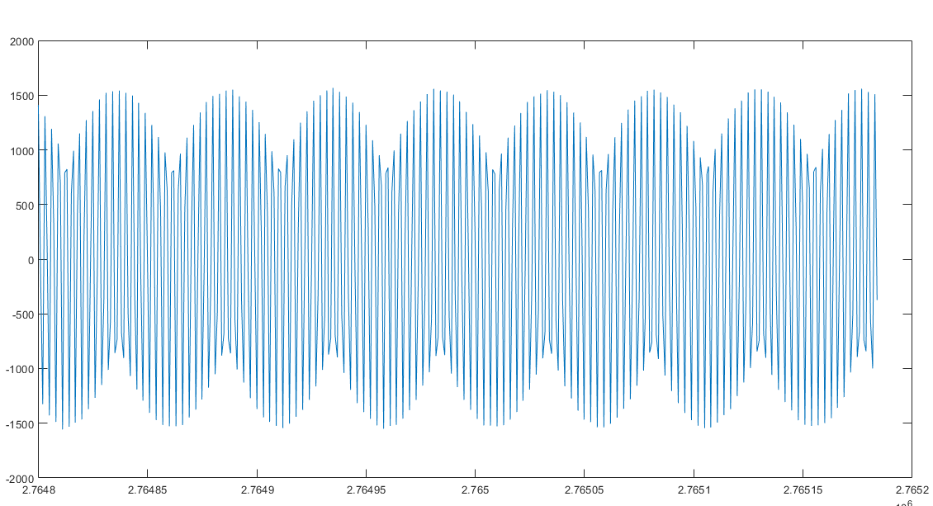
FP2 (EEG R) Channel Closer Look
Subject : S12, night2, FP2
1.5 second data in the midway

Slide 9
Questions
Line noises are usually at 50 Hz and its harmonics (100 Hz, 150 Hz, etc.).
But the frequencies of noises are mainly distributed at around 83 Hz.
Does ZMax headband need to charge?
Other conductivity issues?
skin preparation or gels? -> impedance? fasten loosely?
FP2/EEG R channel -> damage?

